Slide 1
File Management System Calls

Slide 2
creat()
open()
read()
write()
close()
Stat()

Slide 3
Standard I/O streams
POSIX defines the following three standard I/O streams.
Standard stream | Purpose | Default endpoint
stdin | Standard input is the stream of data data (often text) going into a program. | terminal
stdout | Standard output is the stream where a program writes its output data. | terminal
stderr | Standard error is another output stream typically used by programs to output error messages or diagnostics. | terminal

Slide 4
File descriptors
In Unix and related computer operating systems, a file descriptor is an abstract indicator used to access a file or other input/output resources, such as a pipe or network connection.
★ File descriptors form part of the POSIX application programming interface.
★ A file descriptor is a non-negative integer, represented in C programming language as the type int.

Slide 5



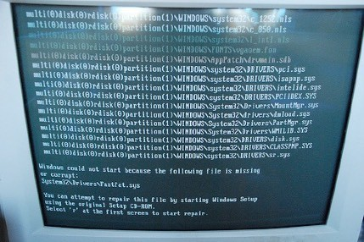




Standard I/O streams and file descriptors
POSIX defines file descriptor values for the three standard I/O streams.
File descriptor value
Standard stream
Mode
Endpoint
stdin
read
terminal
0
stdout
write
terminal
1
stderr
write
terminal
2

Slide 6
File descriptor table
The kernel keeps a table with information about a process’s open file descriptors.

Slide 7



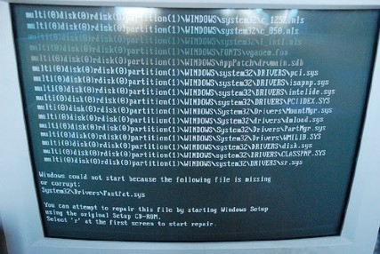


A Process
By default, a process got three open descriptors:
★ stdin
★ stdout
★ stderr
User Space
File descriptor table
Index
Mode
Standard stream
Endpoint
0
read
stdin
terminal
Kernel Space
1
write
stdout
terminal
2
write
stderr
terminal

Slide 8
open()
Open is a system call that is used to open a new file and obtain its file descriptor.
int open(const char *path, int oflags);
Char *path | The relative or absolute path to the file that is to be opened.
int oflags | A bitwise 'or' separated list of values that determine the method in which the file is to be opened (whether it should be read only, read/write, whether it should be cleared when opened, etc).
return value | The file descriptor for the opened file. The file descriptor returned is always the smallest integer greater than zero that is still available. If a negative value is returned, then there was an error opening the file.

Slide 9




Open a file for reading using the open() system call
A Process
User Space
1
int fd;
char buff[BUFF_SIZE];
fd = open("foo.txt", O_RDONLY);
When opening a file for reading, a descriptor number is returned. In this example, a descriptor with value is 3 returned.
1
File descriptor table
Index | Mode | Endpoint
0 | read | terminal
1 | write | terminal
2 | write | terminal
3 | read | foo.txt
Kernel Space
File foo.txt

Slide 10
read()
Read is a system call used to read data from a file into a buffer.
size_t read(int fildes, void *buf, size_t nbytes);
int fildes | The file descriptor of where to read the input. You can either use a file descriptor obtained from the open system call, or you can use 0, 1, or 2, to refer to standard input, standard output, or standard error, respectively.
void *buf | A character array (buffer) where the read content will be stored.
int nbytes | The number of bytes to read before truncating the data. If the data to be read is smaller than nbytes, all data is saved in the buffer.
return value | On success, the number of bytes read is returned (zero indicates end of file). If value is negative, then the system call returned an error.

Slide 11
Reading data from a file using the read() system call
A Process
User Space
2
int fd;
char buff[BUFF_SIZE];
fd = open("foo.txt", O_RDONLY); read(fd, buff, BUFF_SIZE);
Reading data from the file is done by using the descriptor (index) as a reference.
2
File descriptor table
Index | Mode | Endpoint
0 | read | terminal
1 | write | terminal
2 | write | terminal
3 | read | foo.txt
Kernel Space
File foo.txt

Slide 12
write()
write is a system call used to write data from a buffer into a file.
size_t write(int fildes, void *buf, size_t nbytes);
int fildes | The file descriptor of where to read the input. You can either use a file descriptor obtained from the open system call, or you can use 0, 1, or 2, to refer to standard input, standard output, or standard error, respectively.
void *buf | A character array (buffer) where the read content will be stored.
int nbytes | The number of bytes to read before truncating the data. If the data to be read is smaller than nbytes, all data is saved in the buffer.
return value | On success, the number of bytes read is returned (zero indicates end of file). If value is negative, then the system call returned an error.

Slide 13
close()
Close is a system call that is used to close an open file descriptor.
int close(int fildes);
int fildes | The file descriptor to be closed.
return value | Retuns a 0 upon success, and a -1 upon failure. It is important to check the return value, because some network errors are not returned until the file is closed.

Slide 14
stat()
The stat function returns information about the specified file or directory.
int stat(const char *path, struct stat *buf);
Char *path | The relative or absolute path to the file or directory
Struct *buf | Pointer to a structure which will hold the result of the system call
return value | On success, the number of bytes read is returned zero for success. If value is negative, then the system call returned an error.

Slide 15
It returns a stat structure, which contains the following fields:
struct stat {
dev_t st_dev; /* device */
ino_t st_ino; /* inode */
mode_t st_mode; /* protection */
nlink_t st_nlink; /* number of hard links */
uid_t st_uid; /* user ID of owner */
gid_t st_gid; /* group ID of owner */
dev_t st_rdev; /* device type (if inode device) */
off_t st_size; /* total size, in bytes */
unsigned long st_blksize; /* blocksize for filesystem I/O */
unsigned long st_blocks; /* number of blocks allocated */
time_t st_atime; /* time of last access */
time_t st_mtime; /* time of last modification */
time_t st_ctime; /* time of last change */
};

